Slide 1
NEXUS Launchpad
AI INFRASTRUCTURE FOR ACCELERATORS AND VENTURE CAPITAL
AI-Generated Structure
Human Interaction
Investor-Ready Output
Rule-based engine producing startup documentation.
Refined through smart AI-chat.
Investor deck, business plan, and financial model ready to present.
Notes:
Infrastruttura AI

Slide 2

Problem:
Accelerators operate on unstructured startup data
Input Chaos
Time Inefficiency
Economic Limitation
Unstructured input startup data
Inconsistent data
Fragmented input startup data
Long discovery calls
Manual analysis and production
Disconnected AI tools (no centrality workflow)
Repeated work across startups
High dependency on senior time
High internal cost per startup
Limited number of startups managed
Result: constrained revenue and limited capacity

Slide 3



PLATFORM ARCHITECTURE
How Nexus Works
AI-generated structure refined through human interaction
INPUT
S1 — Onboarding Documentation
S2 — Advanced Documentation
📄 Documents
📝 Questionnaire
✏️ Text Input
📑 BMC
Deep-dive analysis and advanced output generation
💰
Financial Snapshot
💬 Feedback
📊 Investor Deck
📑 Business Plan
📈 Financial Model

Slide 4



TECHNOLOGY
Nexus AI Engine
Knowledge Base
Rule - based AI LLM
Output Control
📁 Rules
Deterministic document generation
Flags
→ Rule Documentation
Startup classification logic
Chat
📁 Benchmarks
Benchmark comparison
Questionnaire
→ Startup Classification system

Slide 5
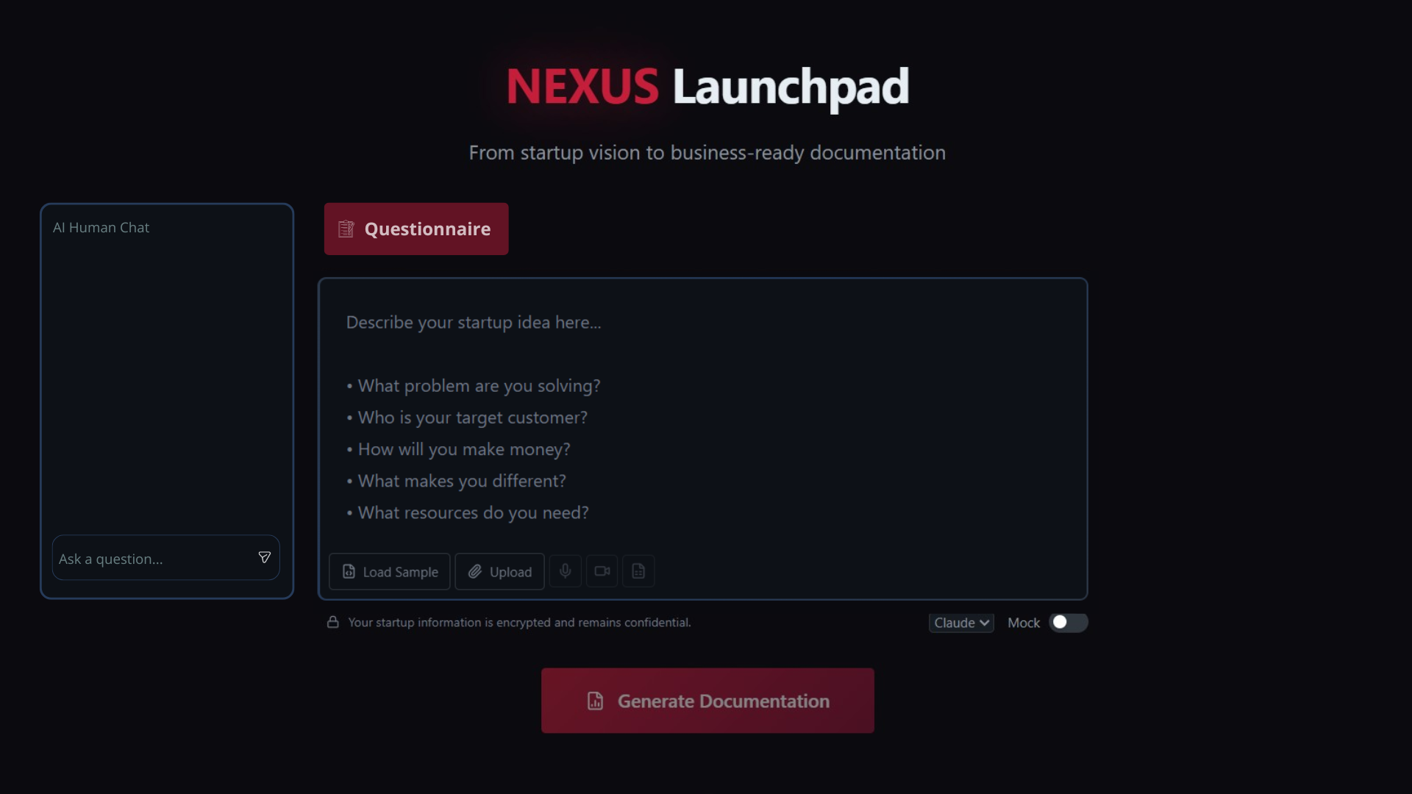

Slide 6

Value for Accelerators
✓
✘
With Nexus
Without Nexus
Onboarding data input startup
automated documentation
faster preparation: save employee costs
scalable workflow: increased capacity
manual analysis and production/Disconneted AI tool
long discovery calls
fragmented documentation
limited scalability
AI GENERATES THE STRUCTURE, HUMAN KEEP STRATEGIC CONTROL.
NEXUS INCREASES ACCELERATOR EFFICIENCY, DOES NOT REPLACES THEIR EXPERTISE
Ricavi - Abbonamento Nexus - Costi interni ridotti
Risparmio costi interni +
aumento capacità
Profitto con Nexus > Profitto senza Nexus
>
>
Ricavi - Costi interni attuali
Abbonamento Nexus
NEW IDEA: Lavorare di più sul critical feedback di S1 e flag considerando S1 uno screening and valutation di startup, puntando ovviamente al risparmio tempo per valutare le startup vendibile al mercato dei venture capital.

Slide 7

COMPETITIVE LANDSCAPE
Market & Competitive Analysis
Categoria
Esempi
Cosa offrono
Buyer principale
Limite rispetto a Nexus
Tool AI per founder
Venturekit, Upmetrics
Pitch & business plan generation
Founders / small teams
Output-focused,
no standardisation
Software per planning esteso
Upmetrics (advanced)
Guided builder & forecasting,
Founders, advisor
Templates, not scalable systems
Accelerator operations
Sopact
International Workflow & reporting tools
Accelerators
Workflow tool, not documentation system
Aggregator AI per accelerators
Nexus Launchpad
Onboarding + investor documentation
Accelerators
Requires clear positioning
Nexus focuses on B2B because accelerators need standardized startup documentation and they can save employee costs, scaling, extra margin.
We are not building a tool. We are building the documentation infrastructure for accelerators.
Oggi tool AI → B2C founders
Acceleratori → ancora processi manuali/no aggregatori AI
Nexus → infrastruttura AI documentale per acceleratori

Slide 8
Work steps
1
2
3
FASE 1 – Costruzione Sistema
FASE 2 – Comunicazione (parte subito)
FASE 3 – Commercializzazione
(0–4 mesi)
Responsabile: Ruben
Operatività: Davina (coordinata da CEO)
Responsabile: CEO
Supporto strategico: Investitori + Ruben
Operatività: CEO
S2 Engineering
Responsabile: CTO (Gabriele)
LinkedIn
Eventi
Posizionamento
Operatività: ML Engineering
Network Investitori
Network Ruben & Gabriele
LinkedIn
Eventi
Sistema AI, Backend & Frontend
Regole
Responsabile: CEO
Operatività: Professore/Esperto Start up
Nota: Collaborazione accelleratore/incubatore: Prodotto free + compenso
Benchmark
Responsabile: CEO
Operatività: Benchmark Analyst
Nota: Collaborazione con accelleratore/incubatore per database startup*

Slide 9

FINANCIALS
Economics
Costi Variabili
Costi Fissi Mensili
Costo S1:
CEO = 4000 €/mese → Gestione generale
Costo S2:
ML Engineer = 4.500 €/mese → Costruzione sistema tecnico e mantenimento
m = 2 —N° rigenerazioni utilizzo chat
25 messaggi= ri-generazione
Gestione operativa della comunicazione e della produzione grafica (Vertice Studio) = 500 €/mese
Prezzo medio S1+S2
Tool / Software = 300 €/mese → CF tecnico sistema
599 €
PS1 + S2
1.999 €
Prezzo per garantire un margine del 60% circa all'acceleratore a start-up considerando un prezzo di mercato pari a 5.000 euro.
Totale CF = 9300 €/mese
N = 5/mese → 60 startup/anno per acceleratore
Break Even Point Mensile:
B.E.P. S1+S2 = 8 acceleratori — C.V.T. = 156 € Margine = 1.8473 €

Slide 10

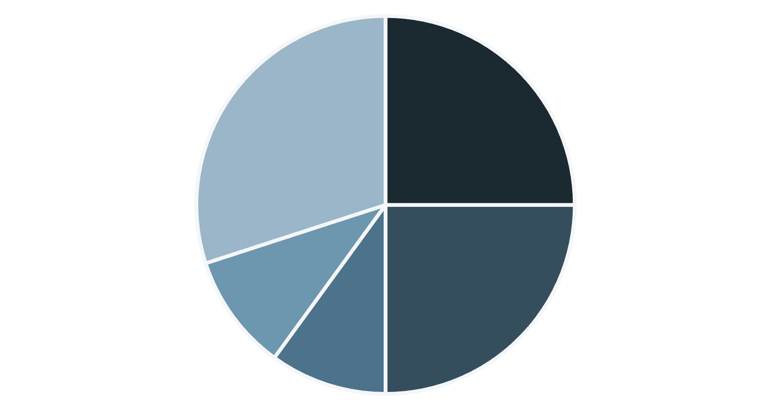
INVESTMENT
Revenue & Richiesta
Revenue mensili bundle NO TAX : 50 × 1.687 € = ~57.546 €/mese
Tot acceleratori = 50 — I primi 8 coprono i costi fissi.
Richiesta: 150.000 € → 20% + Smart Money
Utilizzo dei fondi:
Costruzione Prodotto — 40.000 €
Tools 5 mesi: 5.000 €
ML Engineer 4–5 mesi + Prove: 25.000 € + 10.000
Costruzione Regole (3–5 mesi) — 15.000 €
Collaborazione accelleratore/Professore Univesitario
Benchmark Analyst 5 mesi — 5000 €
Rimborso CEO 5 mesi (Lordo) — 20.000 €
Buffer — 60.000 €
Prodotto
Regole
Benchmark
Rimborso CEO
Buffer
Marketing, co-working, tasse, ritardi / spese maggiori
Espansione Commerciale — Smart Money
Valutazione: 750.000 €

Slide 11
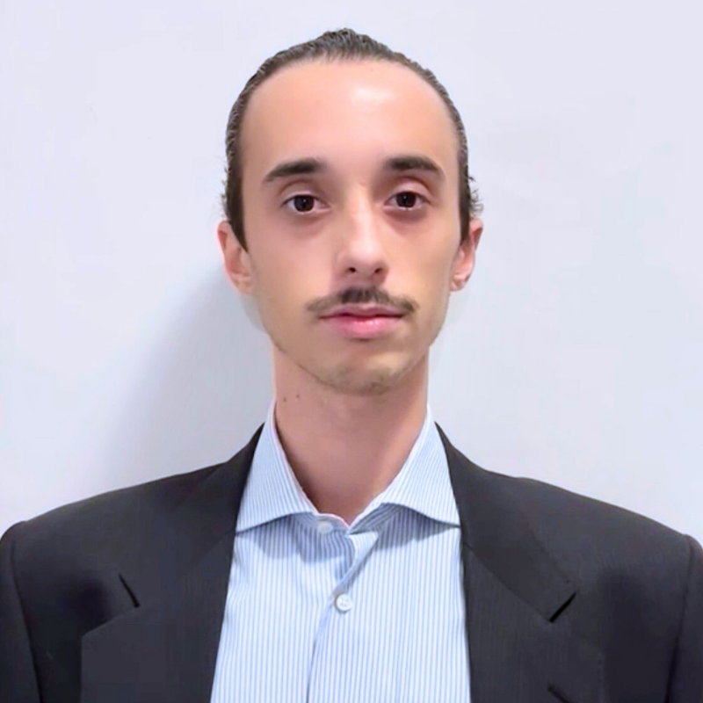
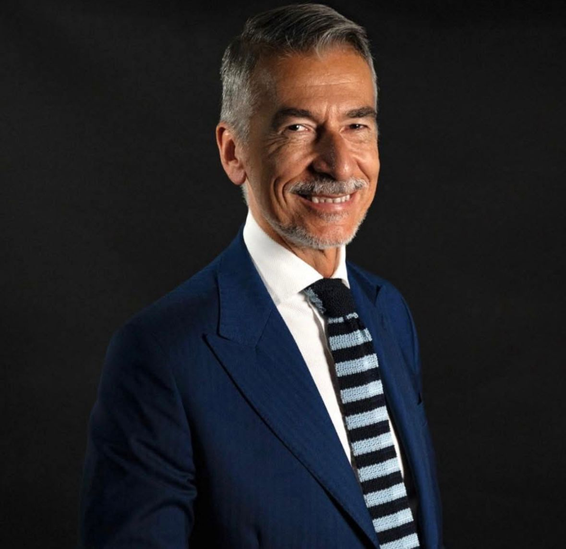
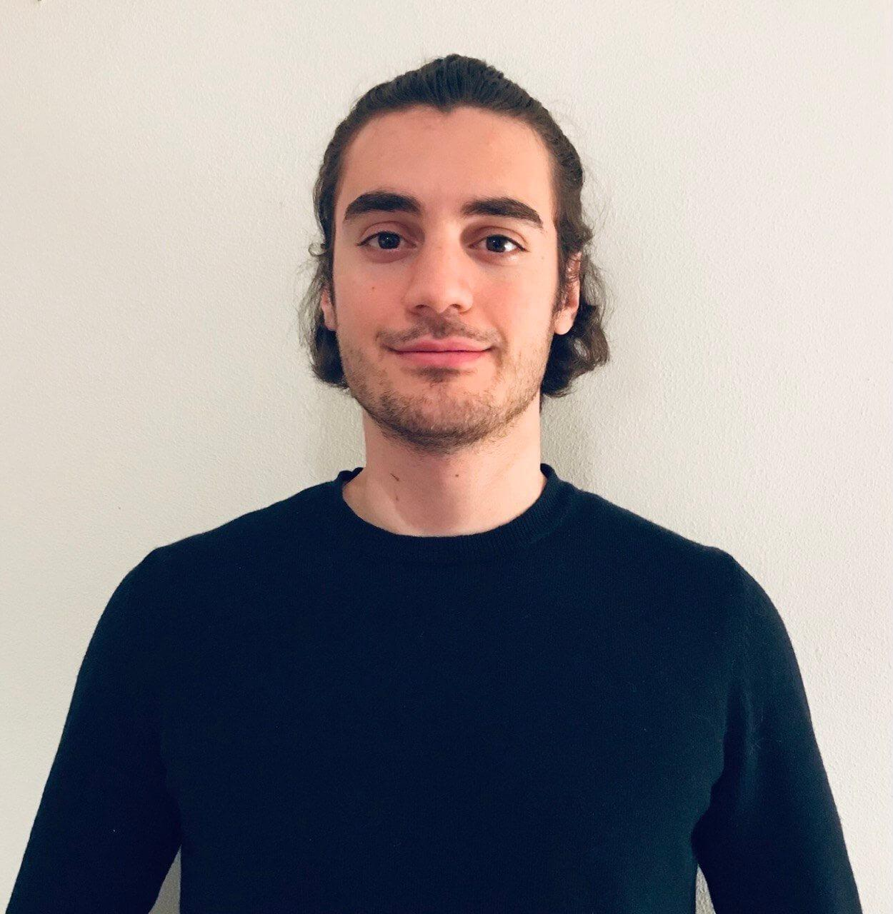
Expertise team
NICOLÒ SANTANGELO
RUBEN ABBATTISTA
GABRIELE TIBONI
MSc Management Engineering
Founder & Strategy Lead at Nexus Venture; Co-Founder & Business Lead at Beebad Italia; IPMA certified in Project Management.
Project Management/ Sales & Business Development / Fundraising / Team Building / Startup Operations.
Communication, PR & Institutional Relations Expert
30+ years at IED as professor, Communication School Director and Director of Management Lab.
Vice President at ISI/ Unione Industriali Torino; communication lead Torino 2008 World Design Capital; Delegate for Communication at ADCI,and External Relations Partner at Fargo Film.
Co-Founded: Associazione Torino Design Week, ADI – Associazione Disegno Industriale, Circolo del Design, Alisei Comunicazione and Spin-To.
Marketing & Communication / Branding / Institutional Relations / PR .
PhD & PostDoc in AI & Robotics
Published 10+ articles in AI; worked across 4 top universities in Europe; selected in Ellis, Eliza, and National PhD AI programmes
Co-founded paperedge.ai, mkind.net, verticestudio.it, hekti.com, keetium.it (10k+ users)
ML / DL / Robotics / SoftEng / Full Stack / Tech lead

Slide 12
TEAM
Il Team
NICOLO SANTANGELÒ
CEO — 51% + €
RUBEN ABBATTISTA
CMO — 10%
GABRIELE TIBONI
CTO — 10%
Area: Generale & Commercializzazione
Area: Comunicazione & Network
Area: Tecnica
Gestione generale
Commercializzazione
Gest. Risorsa: Benchmark Analyst
Gest. Risorsa: Davina (operatività)
Mentor comunicazione
Network & credibility
Ideazione e progettazione
Gestione risorsa: ML Engineering
ML ENGINEER— 9% + €
Operatività
INVESTITORI — 20%
Area: Finanziamento + Network commercializzazione
Liquidità
Smart money
Network & credibility

